Slide 1
CS-6830 Final Project Financial Data Analysis
Maanav Choubey
Aashay Maheshwarkar

Slide 2
Introduction
The Financial Data Analysis project was undertaken to explore the application of machine and deep learning techniques for predicting stock prices using historical data.
The project was motivated by a desire to work with time series data and to gain insights into the explainable AI of neural networks.
LSTM neural networks were used for the prediction task, as they are well-suited for modeling time series data.
Ablation analysis, saliency maps, weights, and SHAP was performed to investigate the importance of each layer and features in the LSTM model and gain insights into the explainable AI of the model.
The project provided hands-on experience with time series data, neural network modeling, and explainable AI, with potential applications in finance and beyond.

Slide 3
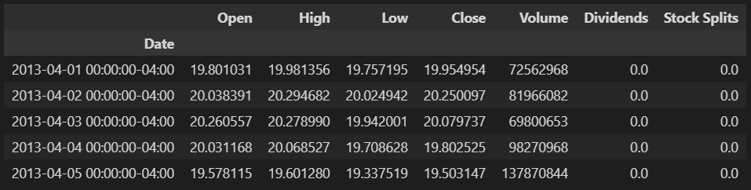
Data Collection
The historical stock price data is collected using Yahoo Finance API.
The data is collected for a specific stock, such as Google (GOOG), for the last 10 years.

Slide 4
Data Preprocessing
The data is preprocessed using the following steps:
The ‘Date’ column which was initially the index of our data frame was converted to date-time format.
The data is scaled using the MinMaxScaler from scikit-learn.
The 'Close' column of the dataset is selected as the target feature.
The data is the split (80% split) into training and testing sets.
Input sequences for the LSTM model are created using the reshape function for our training set.

Slide 5
Modeling DL
An LSTM neural network is used to predict future stock prices.
The LSTM model is built using the Sequential API of TensorFlow.
The LSTM model architecture consists of three LSTM layer with 50 units each, followed by one Dense layer.
The model is compiled using the 'adam' optimizer and 'mean squared error' loss function.
The model is trained on the training set for a 50 epochs.

Slide 6
Modeling ML
In addition to the LSTM neural network, we also train a decision tree model on the same dataset for comparison purposes.
The decision tree model is built using the DecisionTreeRegressor class from scikit-learn.
The model is trained on the same training set as the LSTM model.
The performance of the decision tree model is evaluated using the Mean Squared Error (MSE) metric on the testing set.

Slide 7
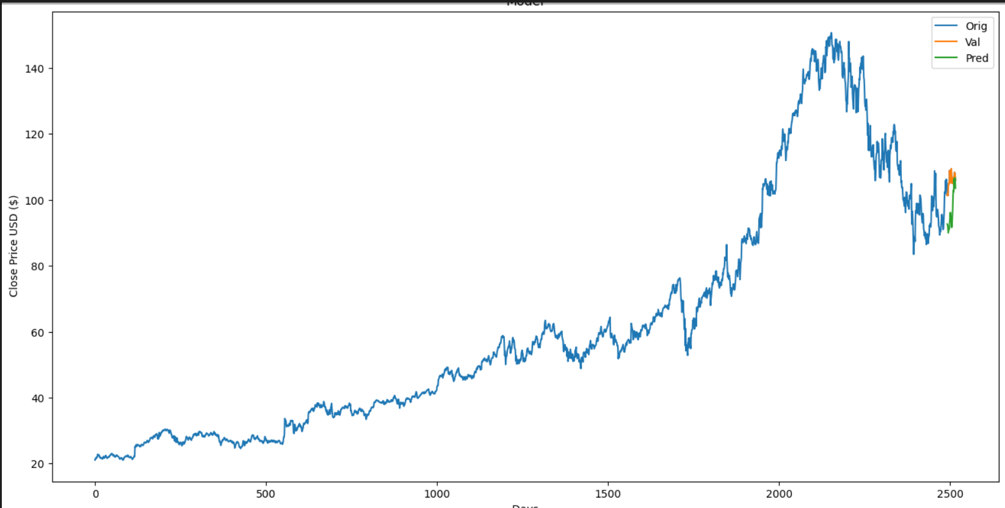
Results Obtained
The trained Decision Tree model is able to predict future stock prices with reasonable accuracy.
The model's performance is evaluated using the Mean Squared Error (MSE) metric.
The MSE obtained on the testing set is approximately 49.75.

Slide 8
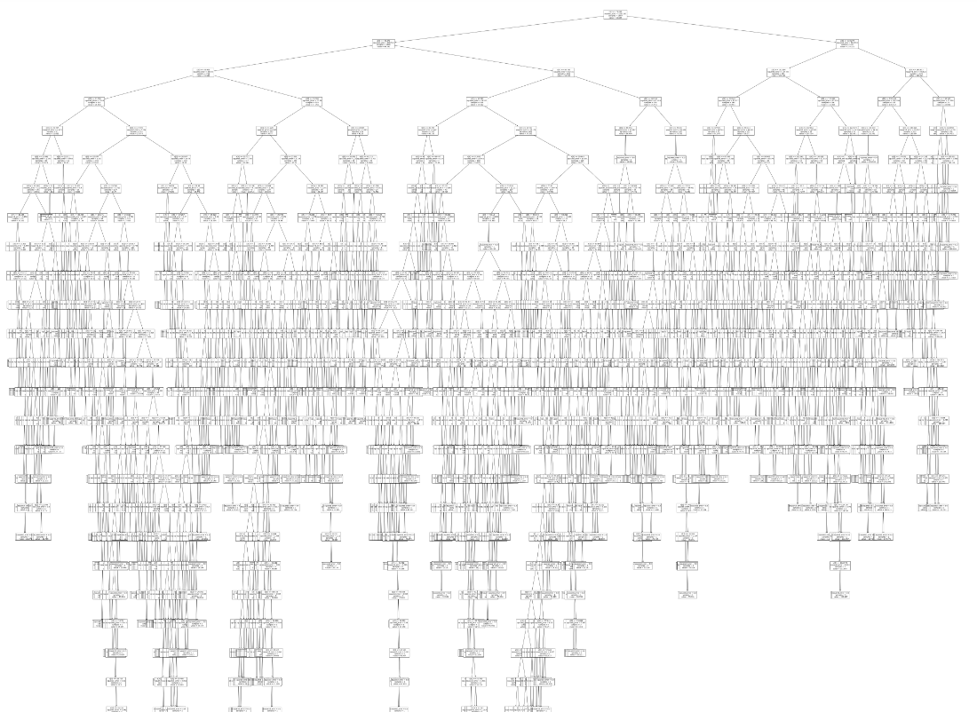
Decision Tree

Slide 9
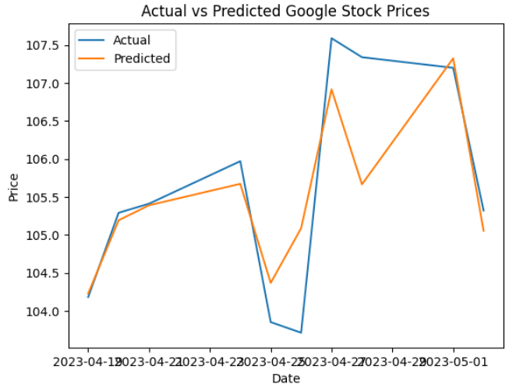
Random Forest Regressor
The trained Random Forest Regressor model is able to predict future stock prices with better accuracy than decision trees.
The model's performance is evaluated using the Mean Squared Error (MSE) metric.
The MSE obtained on the testing set is approximately 0.43.

Slide 10
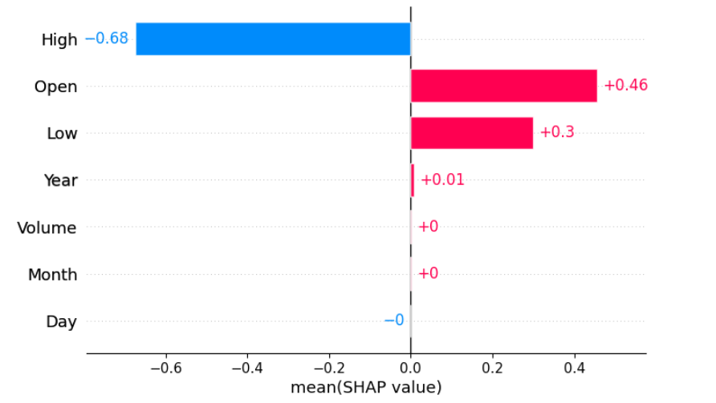
Feature Importance of RF
We used a library SHAP (SHapley Additive exPlanations) to look at the feature importance of our RF model.
It’s a game theoretic approach to explain the output of any machine learning model.
It connects optimal credit allocation with local explanations using the classic Shapley values from game theory and their related extensions (see papers for details and citations).

Slide 11
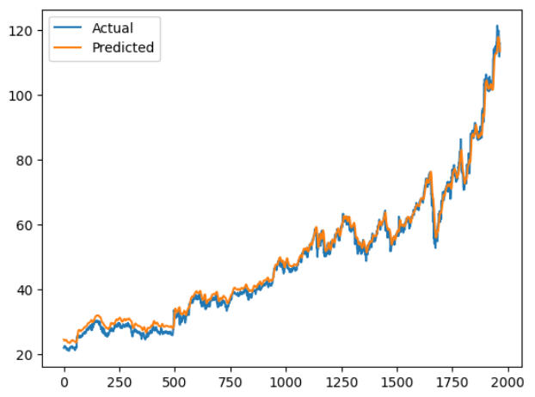
LSTM Neural Net
The trained LSTM Neutral network model is performed the best out of the other classifiers.
The model's performance is evaluated using the Mean Squared Error (MSE) metric.
The MSE obtained on the training set is approximately 0.0002 and on testing set 0.0009.

Slide 12
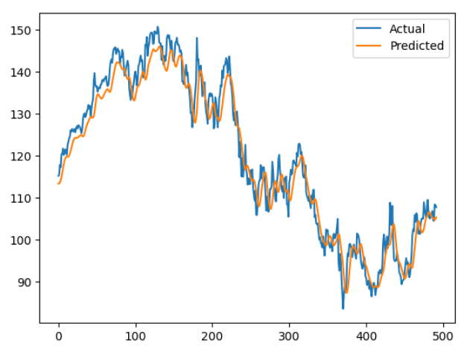
Testing LSTM

Slide 13
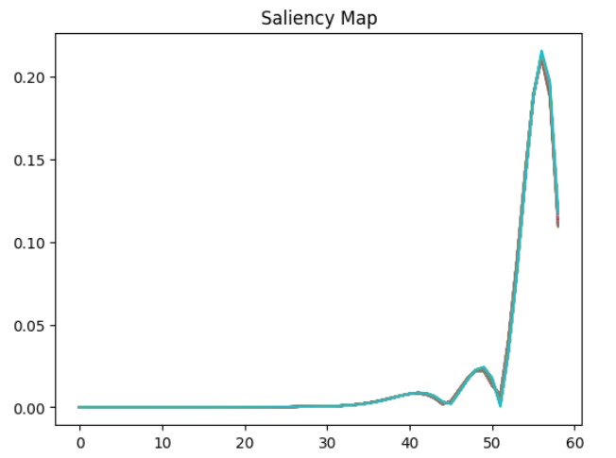
Saliency maps
One popular technique in interpreting neural networks like CNN is to plot a saliency map out of them.
We implemented the same on our LSTM neural network with the time series data.
We can clearly see the gradients values for first 50 samples on the y axis and the x axis indicating the time steps.

Slide 14
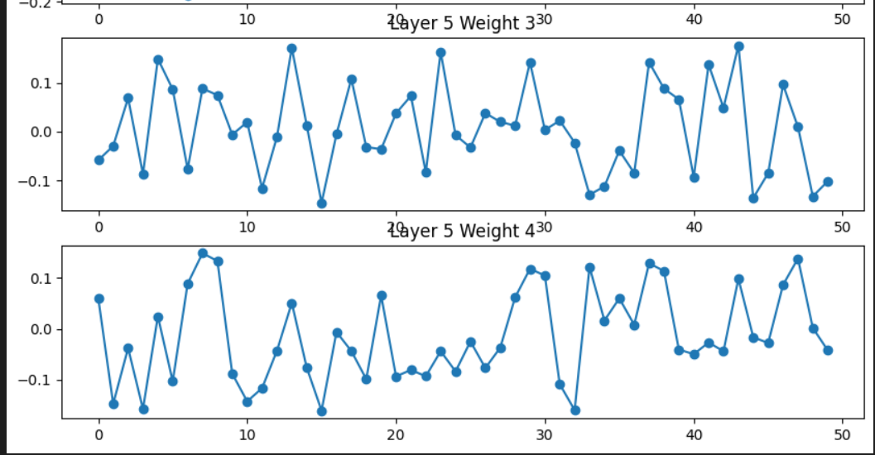
Weights for each layer
Another way to interpret LSTM neural networks trained on time series data is by visualizing the weights from each layer.
By examining the weights, we can gain insights into the features that the neural network has learned.
This understanding can guide modifications or changes to the neural network, potentially leading to improved performance.
X-axis represents the number of units in the Layer and Y-axis the weights.

Slide 15
Analysis
The SHAP analysis is performed to investigate the importance of each feature in the Random Forest Regressor.
The High feature gives us the best positive relation with our target close, and Open feature leads to negative relation with our target.
The results of the saliency maps suggests that the most significant change in the gradients takes place from 50 to 60 time-steps. We can adjust our lookbacks after looking at these results.
The results of the weights analysis show that the last LSTM layer is the most important layer, followed by the second LSTM layer.

Slide 16
Lessons Learned
It is important to preprocess the data properly before feeding it to the LSTM model.
The architecture of the LSTM model should be chosen carefully based on the problem at hand.
The performance of the LSTM model can be improved by adjusting the hyperparameters and adding more layers.
More interpretability techniques for the neural networks can be explored as XAI of Time-series data still remains a black box.
The features importance and model learning at each step of the neural network can be explored to explained.

Slide 17
Future Work
One potential future direction is to perform XAI (explainable AI) on the LSTM model trained on time series data.
XAI techniques can help us understand how the LSTM model arrives at its predictions, which can be useful for building trust and ensuring fairness.
One approach for XAI on LSTM models is to use Layer-wise Relevance Propagation (LRP), a technique for attributing the contribution of each input feature to the final prediction.
By performing XAI on our LSTM model, we can gain a deeper understanding of how it works and potentially improve its performance and interpretability.

Slide 18

Thankyou!

